Slide 1


EXPLoraTORY DATA ANALYSIS FOR MTA DATASET IN PANDEMIC
SILA KAzAN
SEYİT FURKAN BOZKURT
SERHAT KAHRAMAN
ELİF YILGIN
BERKAY YÖN
12.11.2021

Slide 2
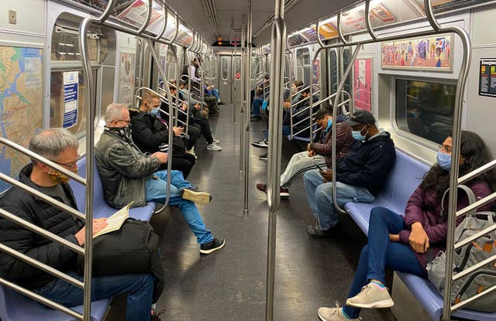
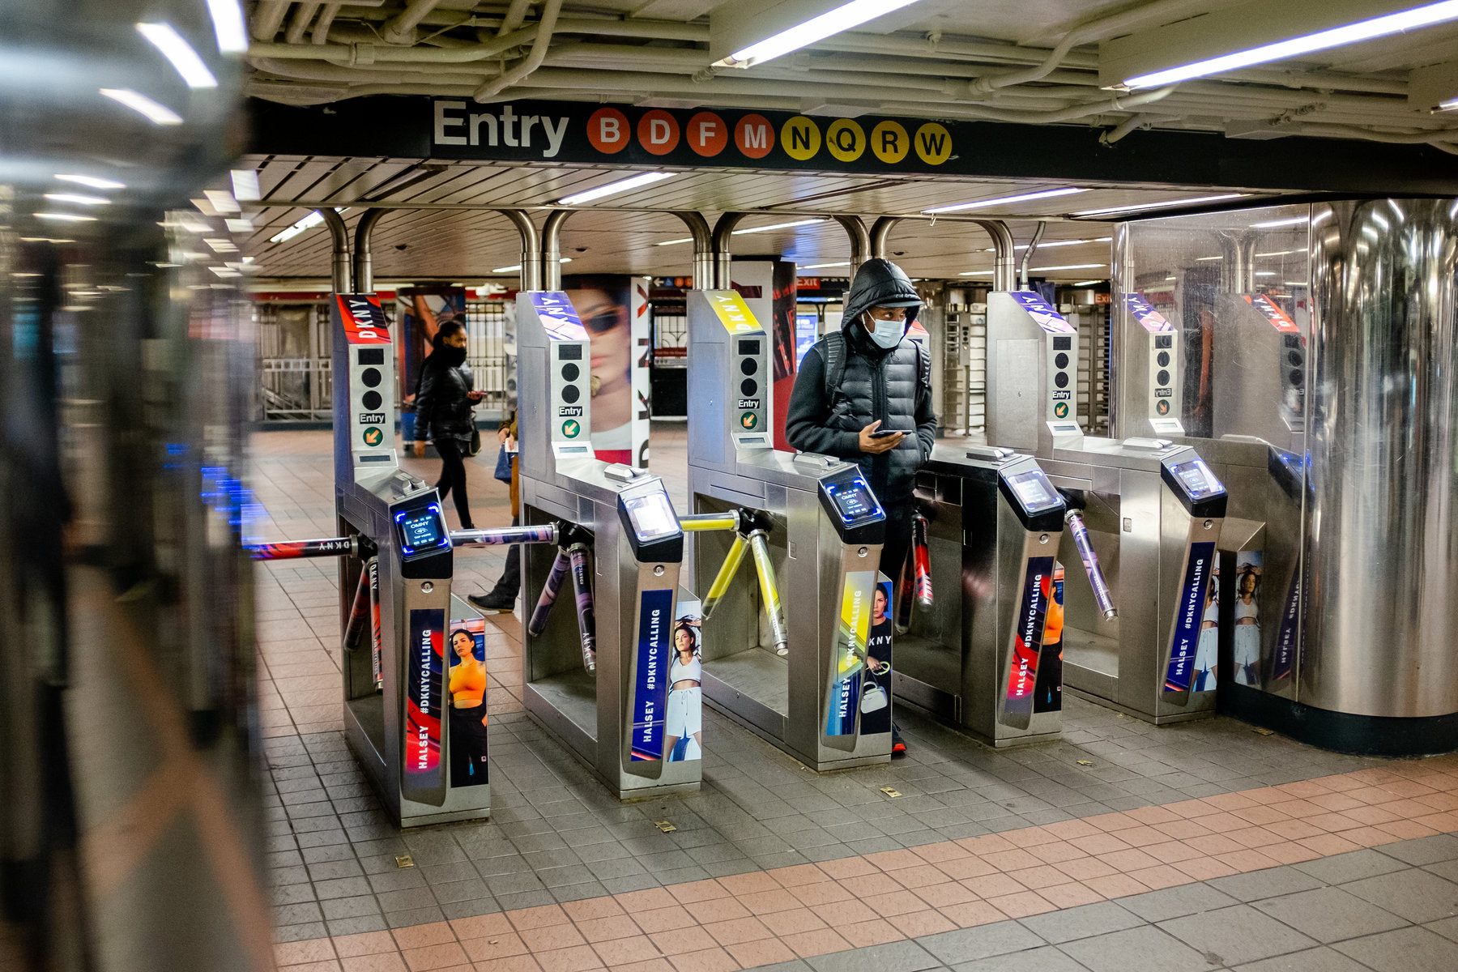
INTRODUCTION
BUSINESS NEED: Specifying usage of transportation frequency in pandemic
OBJECTIVE : Finding the busiest subway stations, most crowded day and best time slot.
SOLUTION: Using MTA Turnstile and analyse to find best placement for comfort transportation. To show, visualize the data to users.

Slide 3
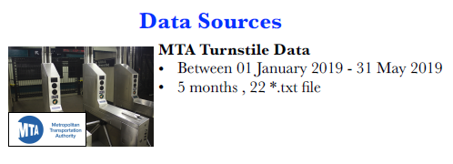


METHODOLOGIES AND TOOLS
Between 2019-03-02 and 2019-08-27
(6-Month Data)
Between 2020-02-29 and 2020-08-27
(6-Month Data)
Between 2021-02-27 and 2019-08-27
(6-Month Data)

Slide 4
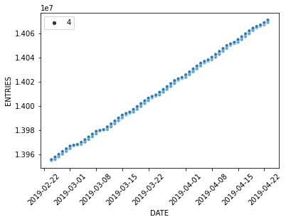
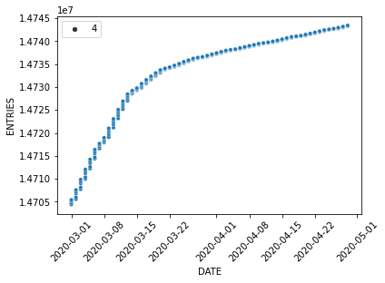
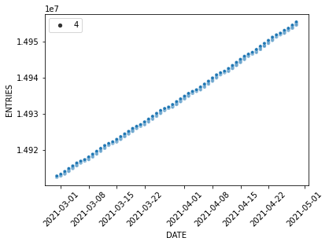
COMparatıve statıstıcs for 3 dıstınct years
BEFORE COVID
DURING COVID
AFTER COVID

Slide 5
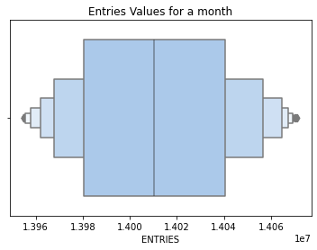
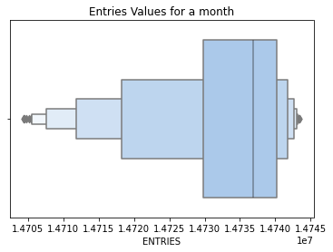
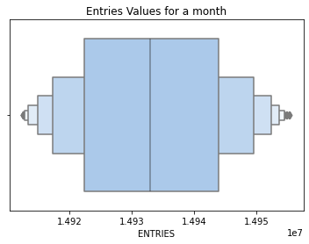
COMparatıve statıstıcs for 3 dıstınct years
BEFORE COVID
DURING COVID
AFTER COVID

Slide 6
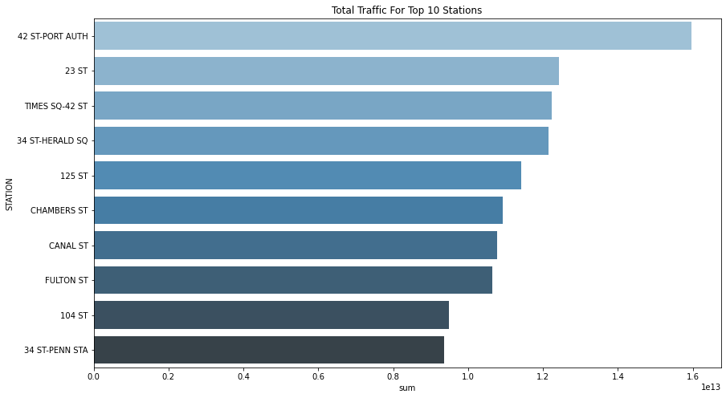
Busıest statıons for 3 dıstınct years
BEFORE COVID

Slide 7
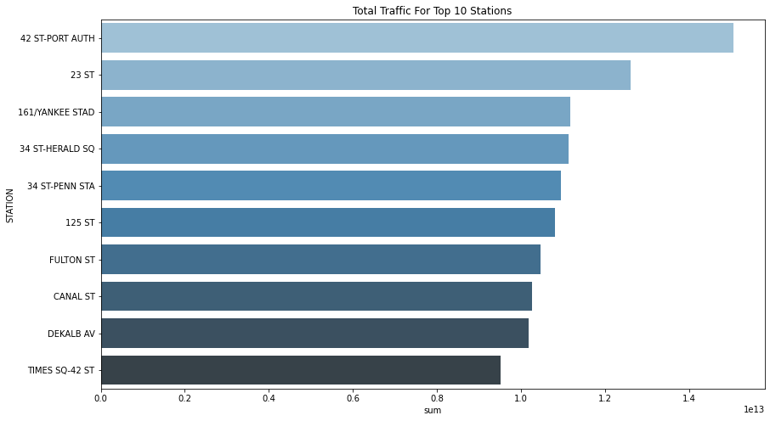
DURING COVID

Slide 8
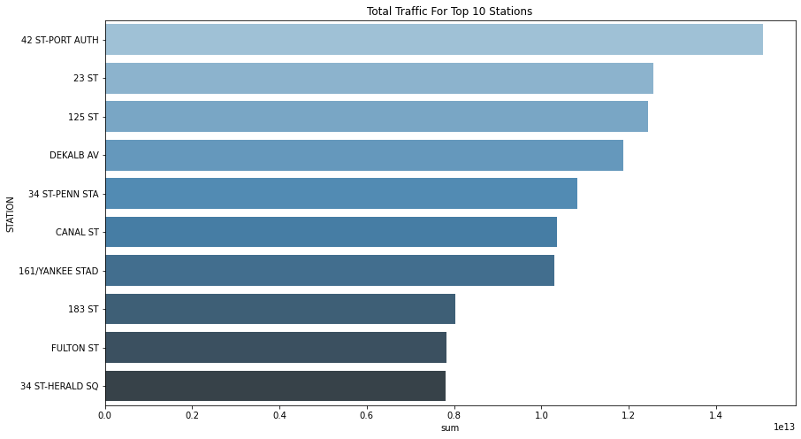
AFTER COVID

Slide 9
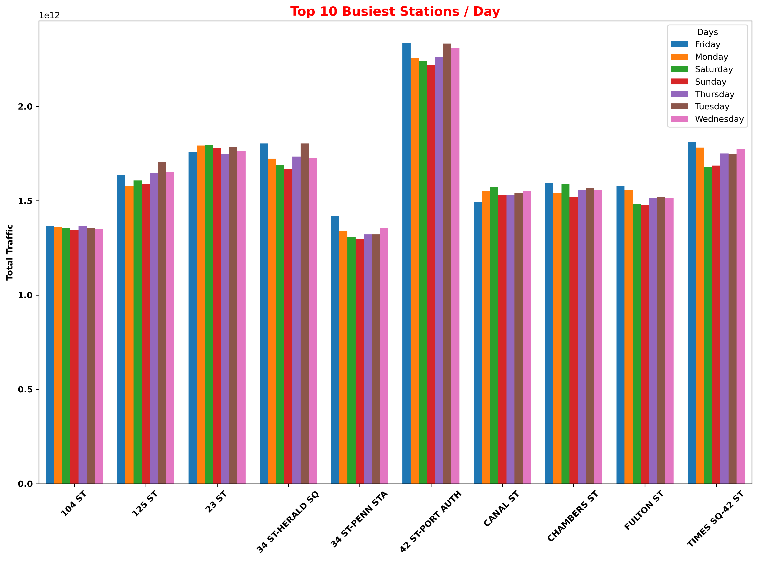
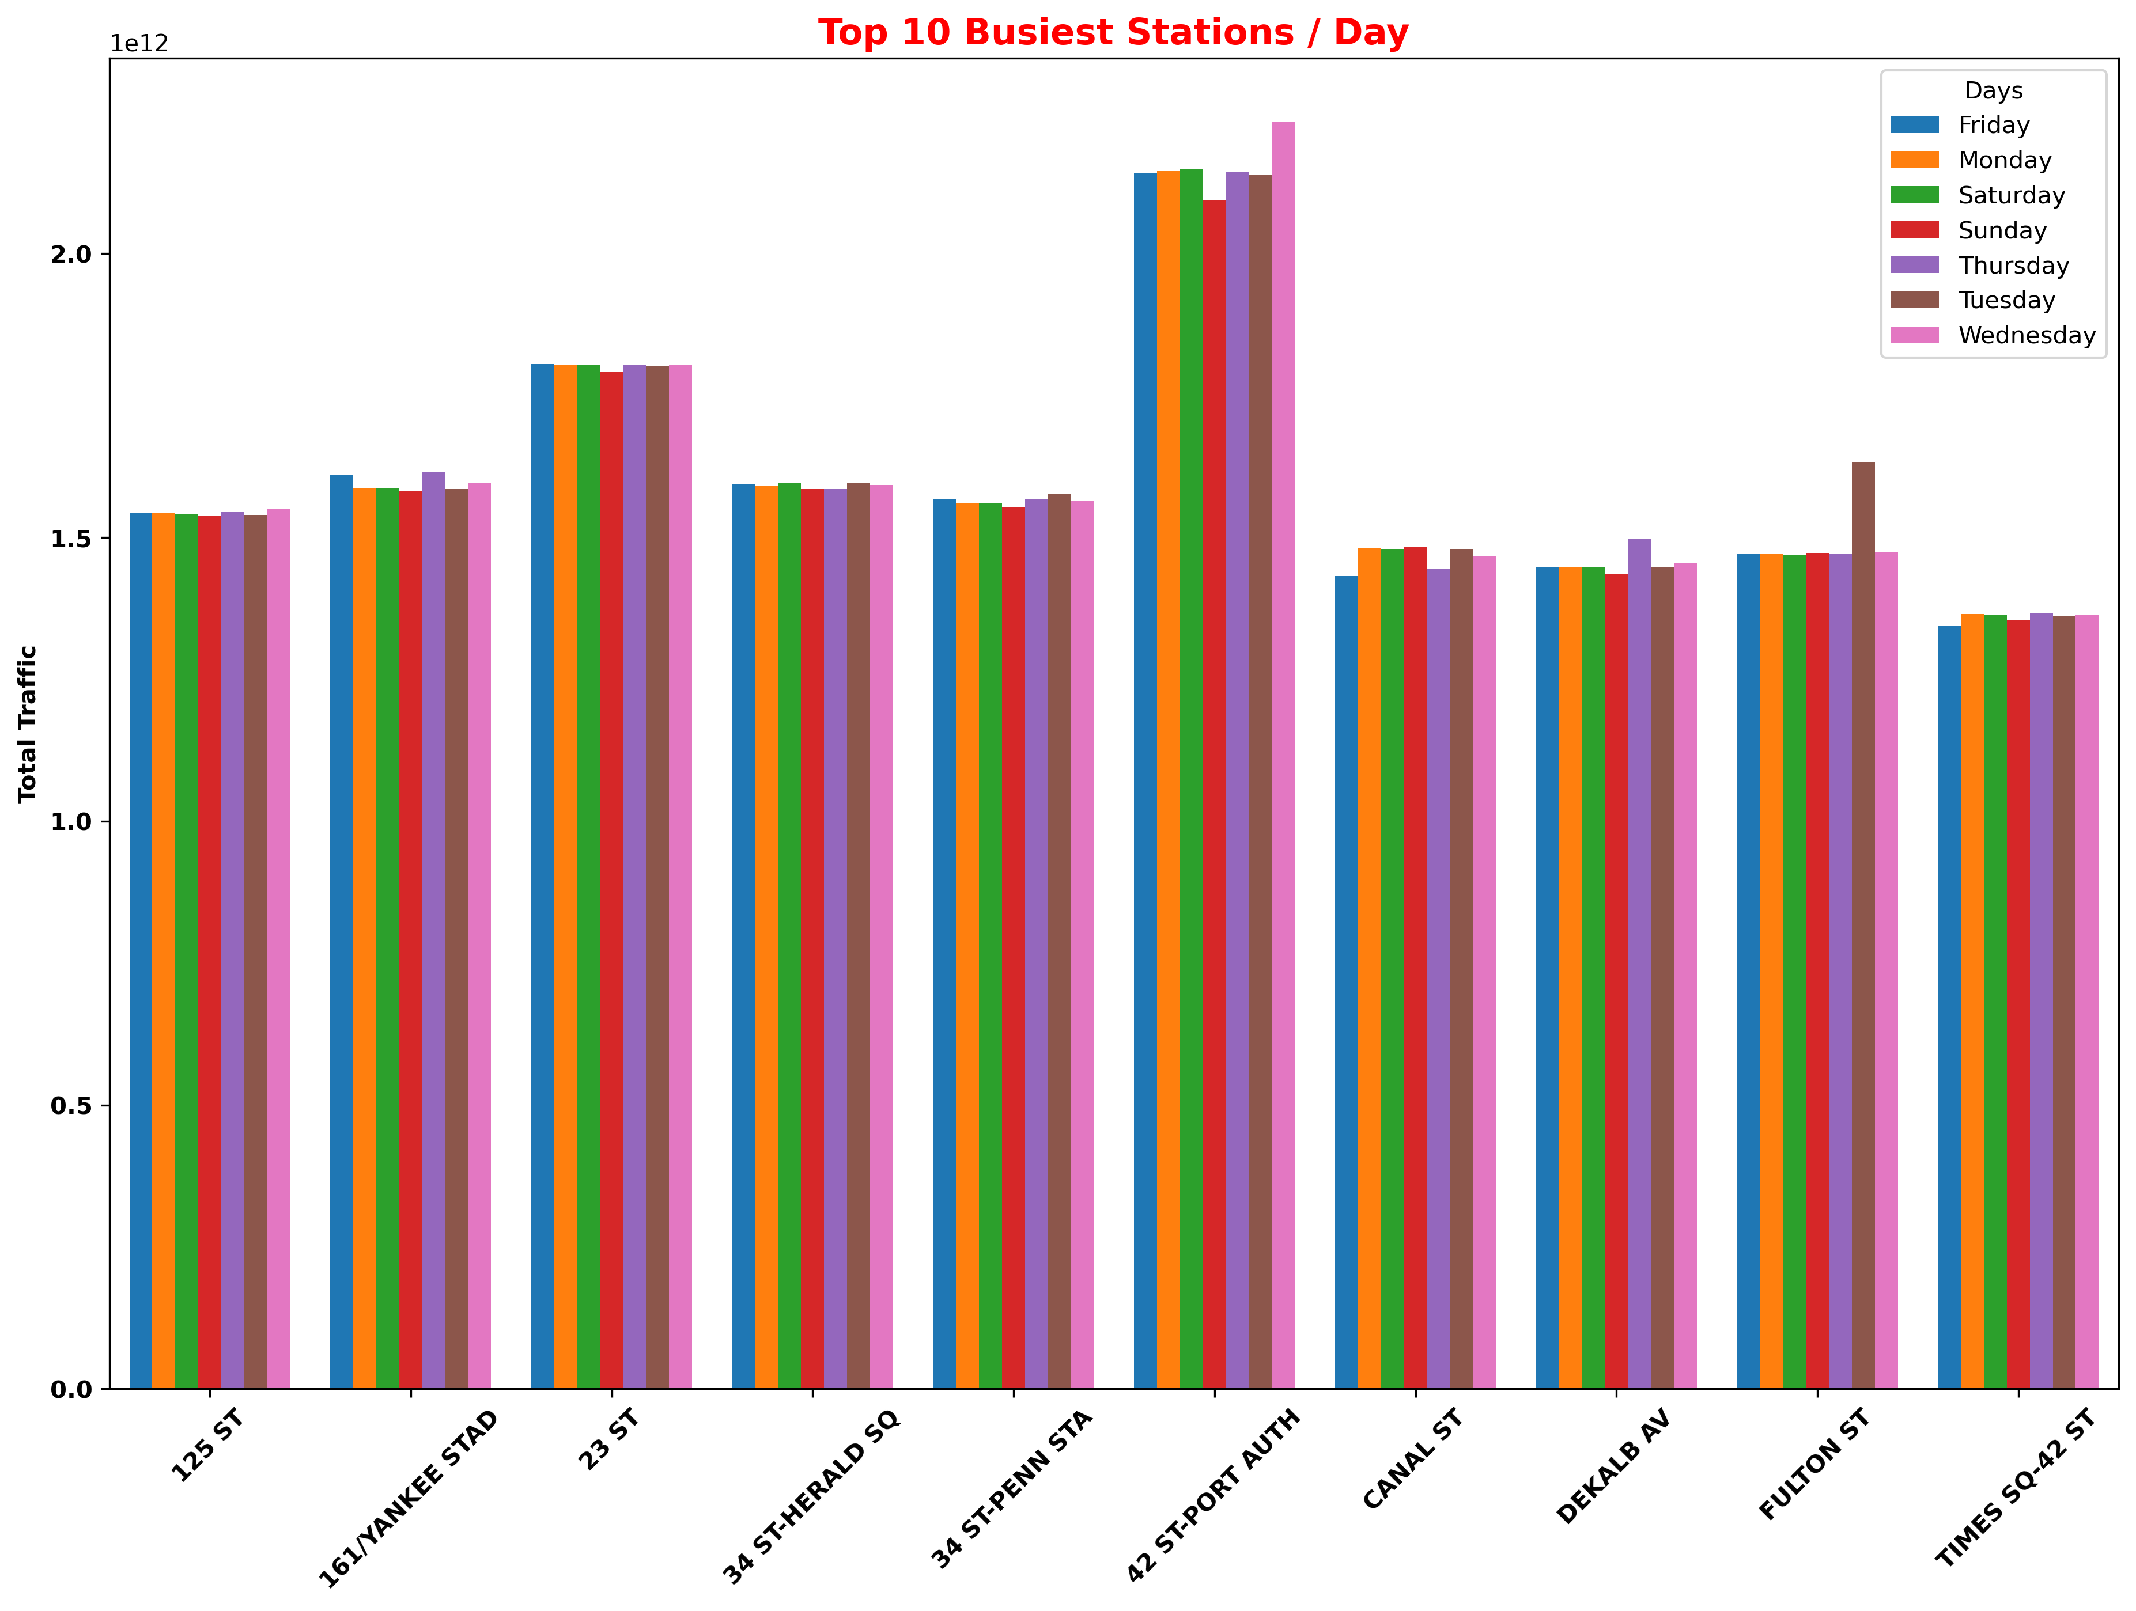
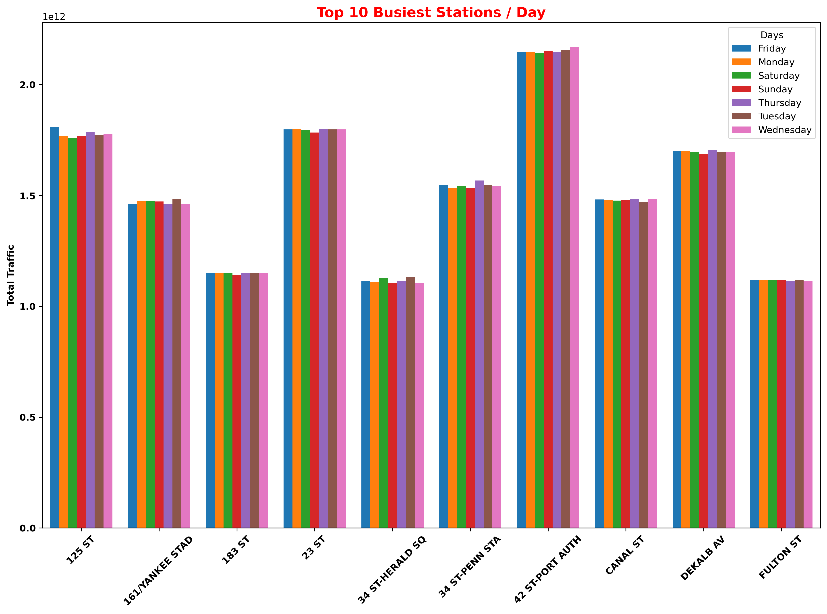
Busıest statıons per day for 3 dıstınct years
AFTER COVID
BEFORE COVID
DURING COVID

Slide 10
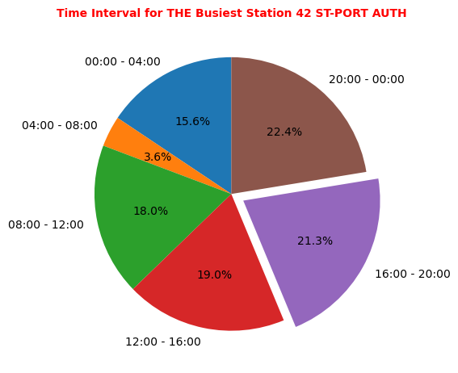
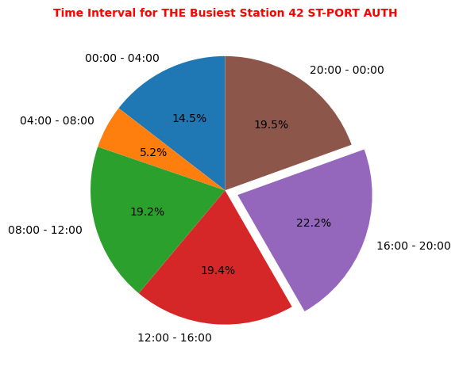
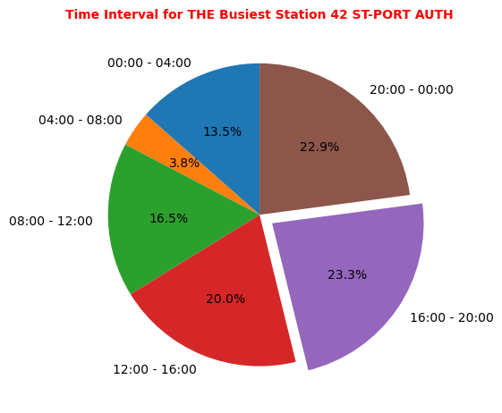
Traffıc of 4 hour set ın busıest statıon
AFTER COVID
BEFORE COVID
DURING COVID

Slide 11
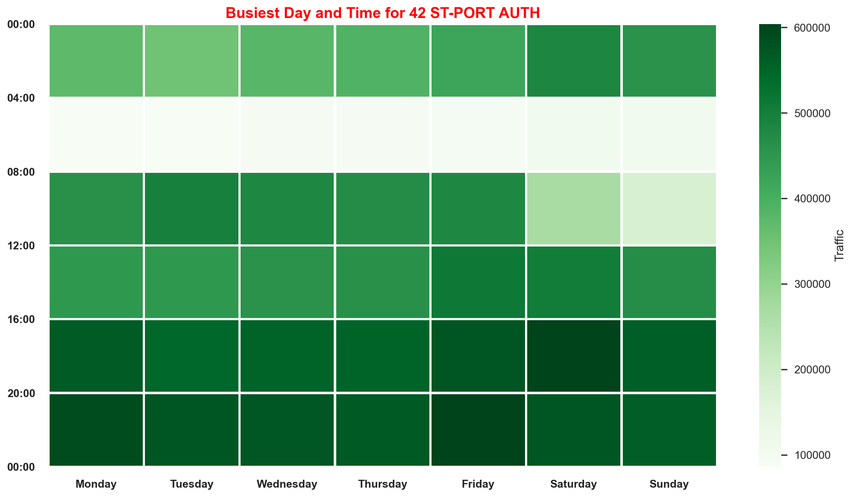
Traffıc of 4 hour set ın busıest statıon
BEFORE COVID

Slide 12
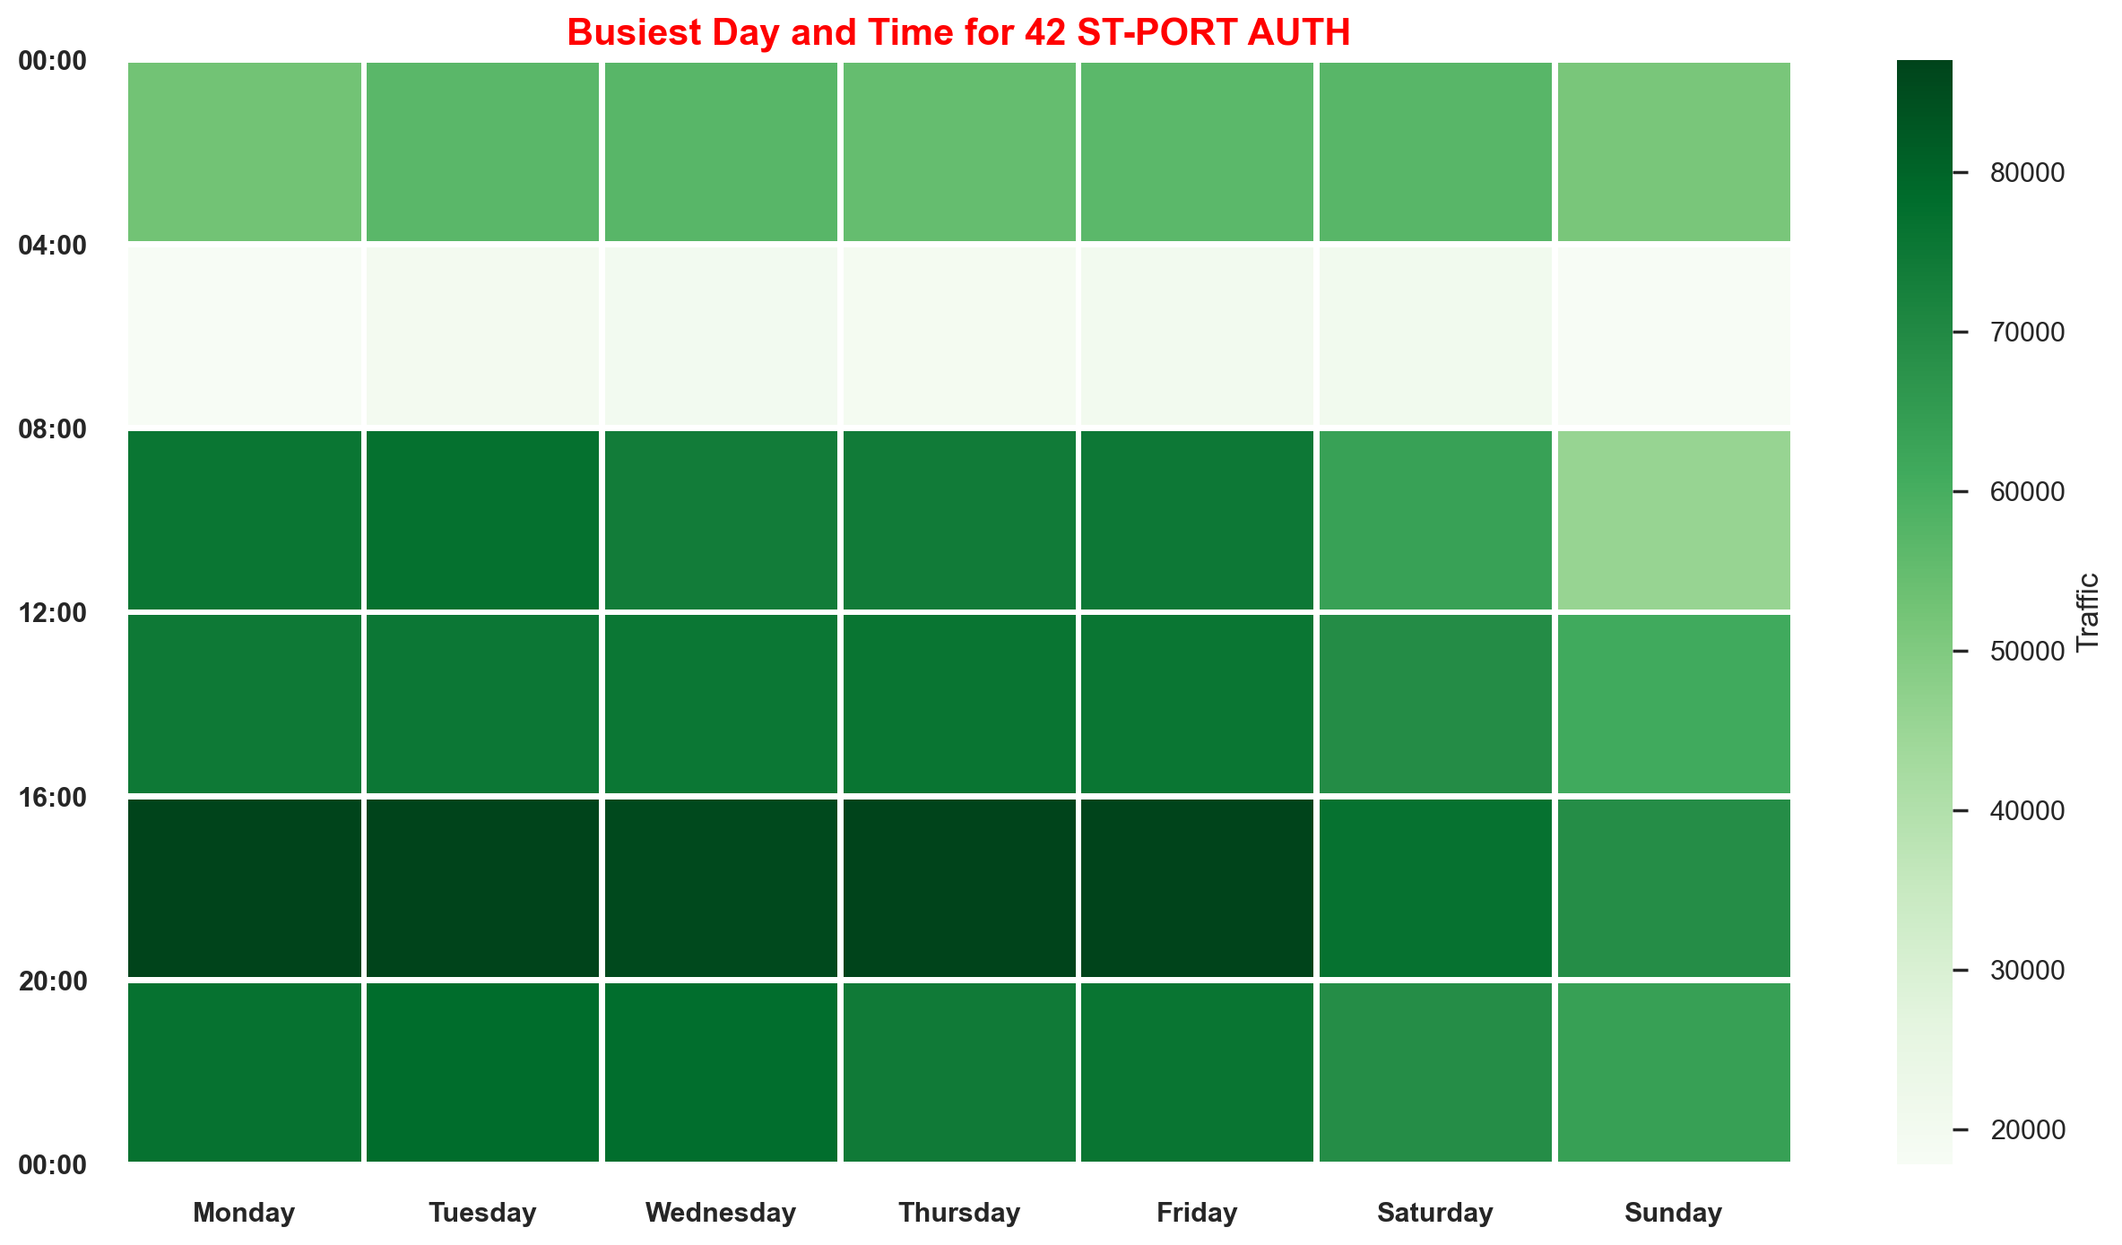
DURING COVID

Slide 13
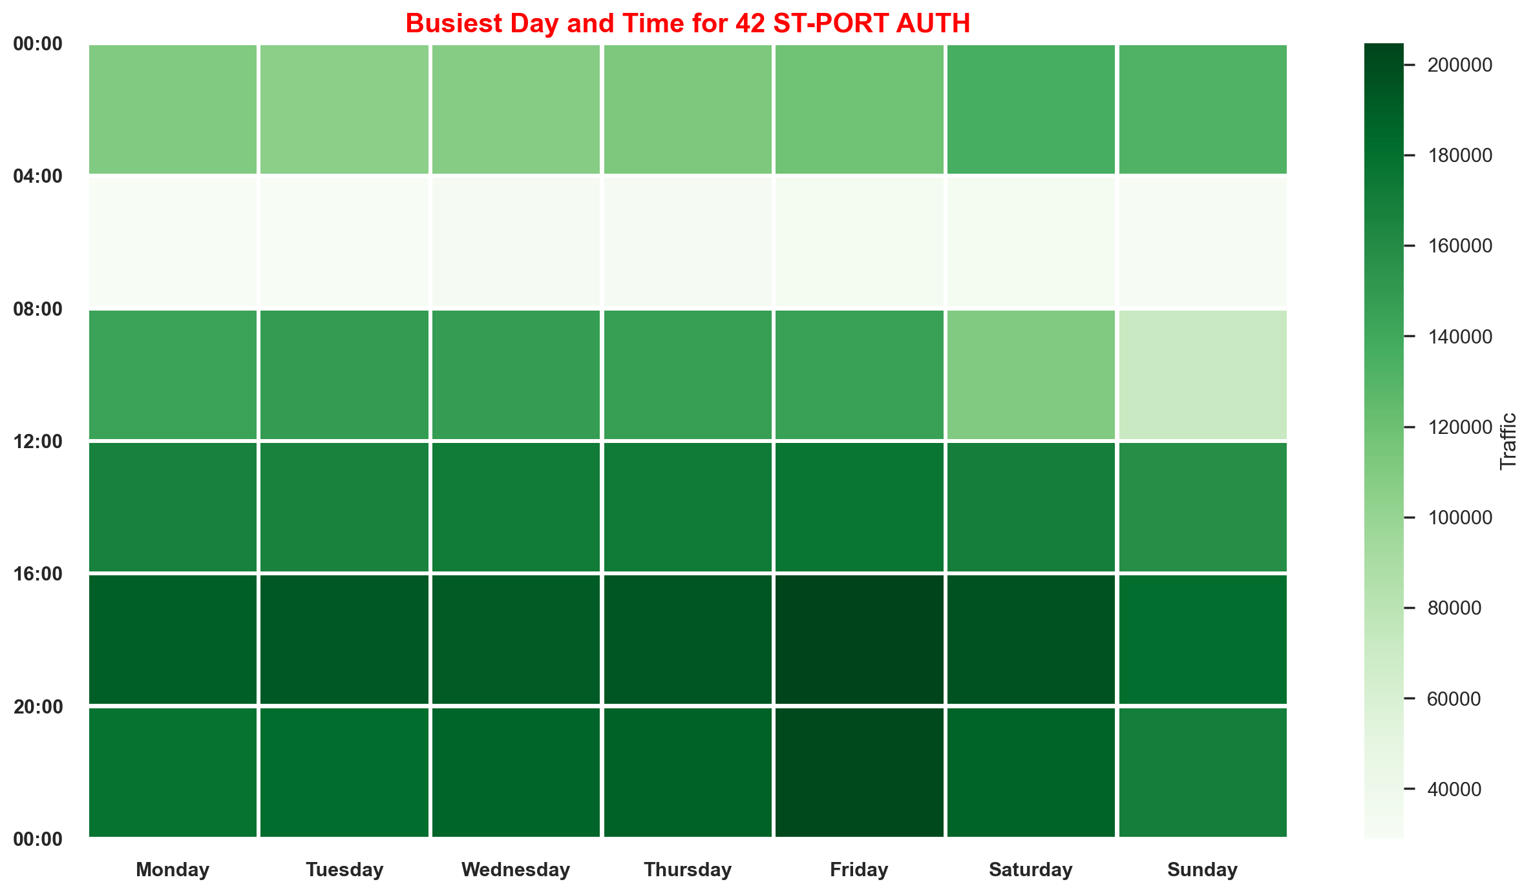
AFTER COVID

Slide 14
Future work
These dataset can be considered as the location of Business and Technology Center throughout the city.
Other transportation usage may be observed; so traffic transition that is used by passengers or people will be get.
Dataset can be extended.

Slide 15
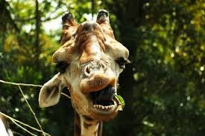
Thanks for watchıng
https://github.com/silakazan
https://github.com/Serhatkahraman1
https://github.com/SeyitFurkan
https://github.com/elifyilgin
https://github.com/berkayyn

